Slide 1








www.slidesgo.es
PIZZA SALES ANALYSIS
SQL
Turning Raw Data into Actionable Insights

Slide 2


—HELLO FOLKS !!
I am Abdul Sattar, a Data Analyst with expertise in SQL. In this project, I utilized SQL to analyze a structured dataset, answering key business questions and extracting valuable insights to drive informed decisions.

Slide 3

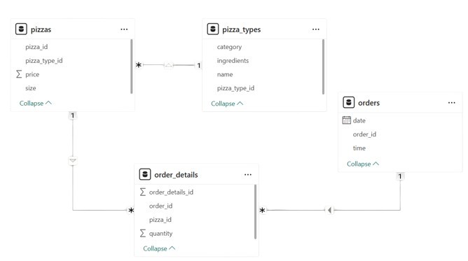

Data Model View

Slide 4
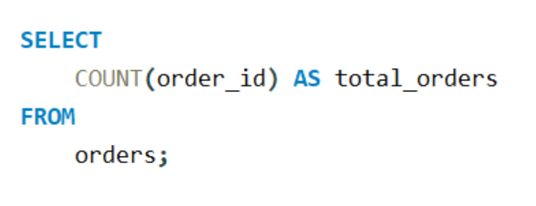
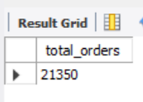
Retrieve the total number of orders placed

Slide 5
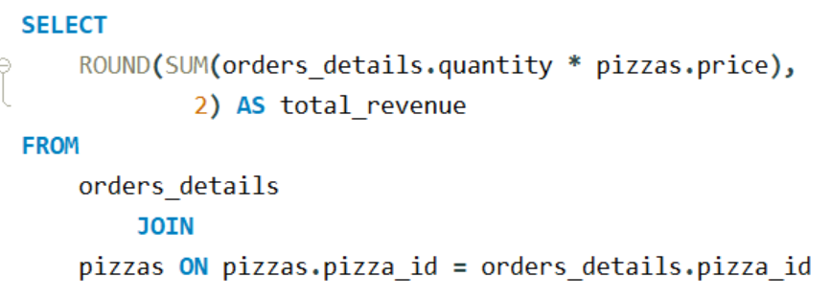
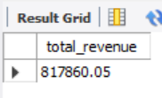
Calculate the total revenue generated from pizza sales

Slide 6

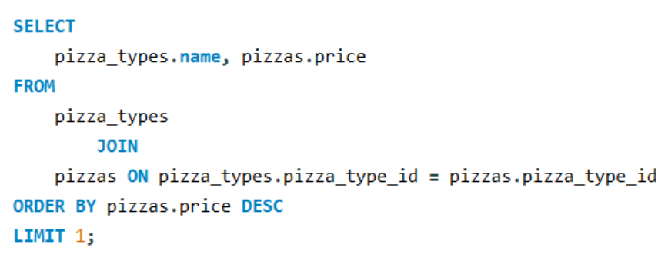
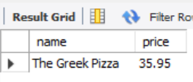
Identify the highest-priced pizza

Slide 7

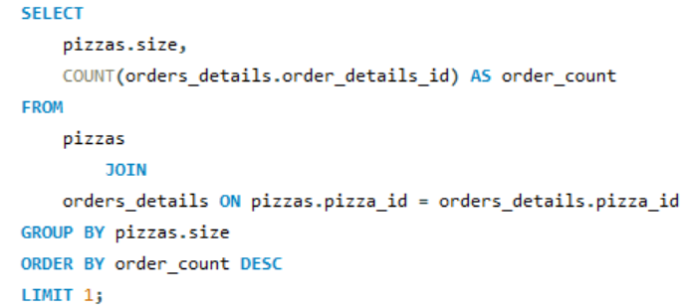
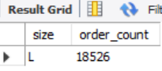
Identify the most common pizza size ordered

Slide 8
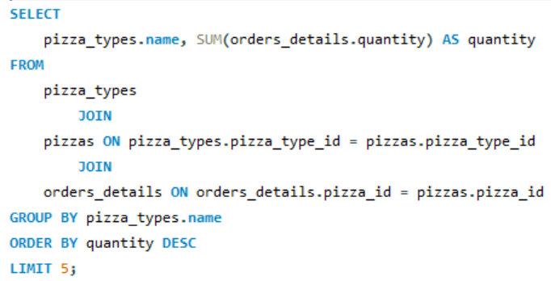
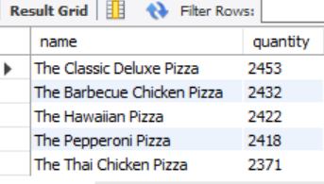
List the top 5 most ordered pizza types along with their quantities

Slide 9
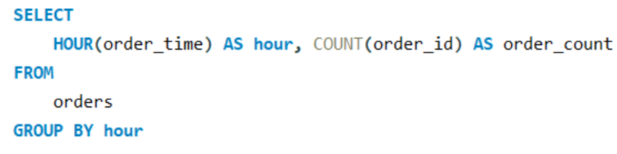
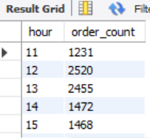
List the top 5 most ordered pizza types along with their quantities

Slide 10

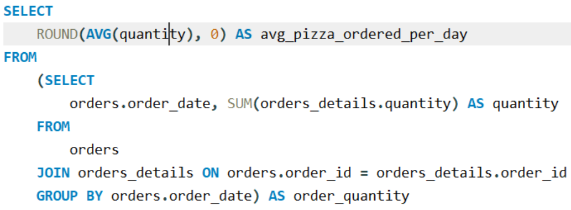
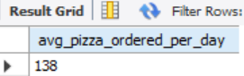
Calculate the average number of pizzas ordered per day

Slide 11
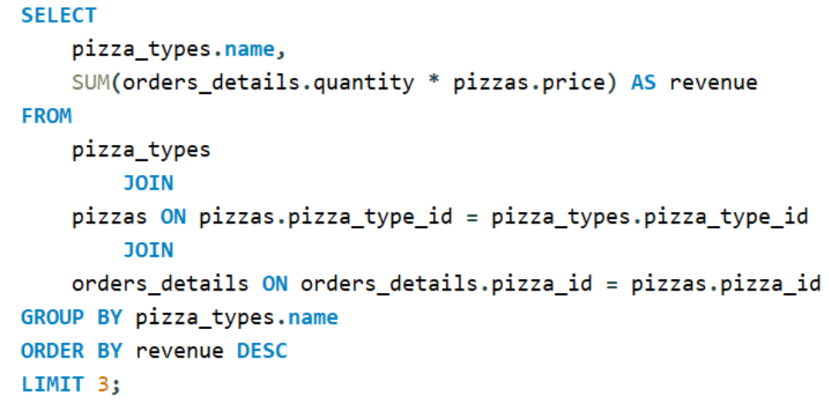
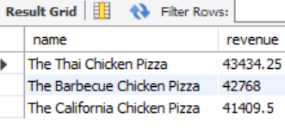
Determine the top 3 most ordered pizza types based on revenue

Slide 12
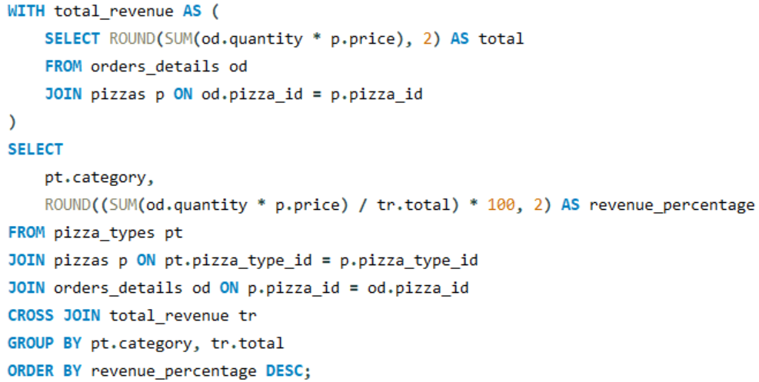
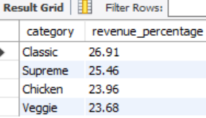
Calculate the percentage contribution of each pizza category to total revenue.

Slide 13

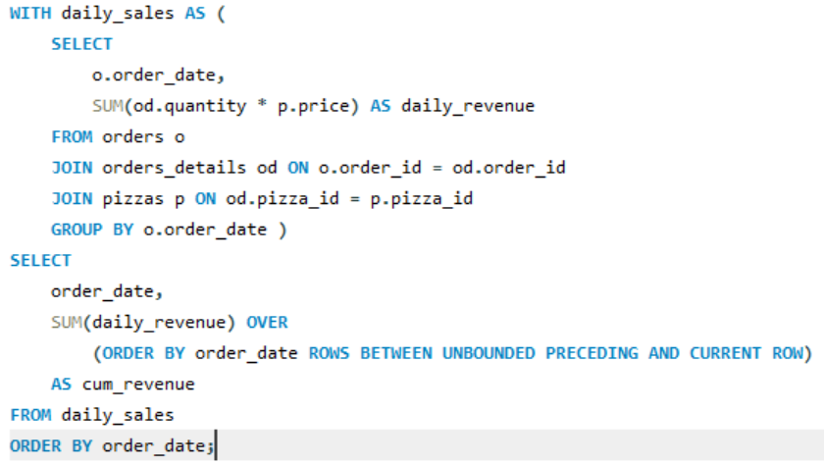
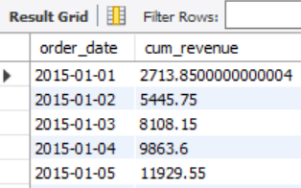
Analyze the cumulative revenue generated over time

Slide 14
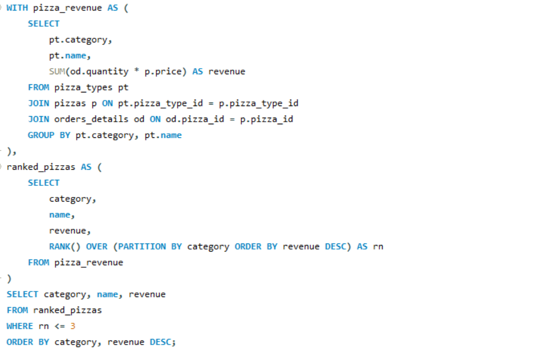
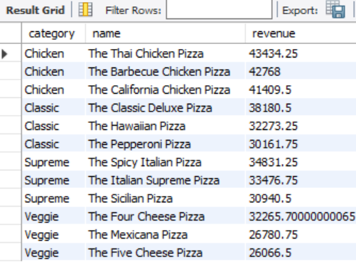
Determine the top 3 most ordered pizza types based on revenue for each pizza category

Slide 15

THANKS
abdulsattardayo44@gmail.com
https://www.linkedin.com/in/abdul-sattar-dayo/

